Slide 1

How can data science be used for the good of society?
Ian LeBruce &
Gosia Bezwinska
09/03/2023

Slide 2
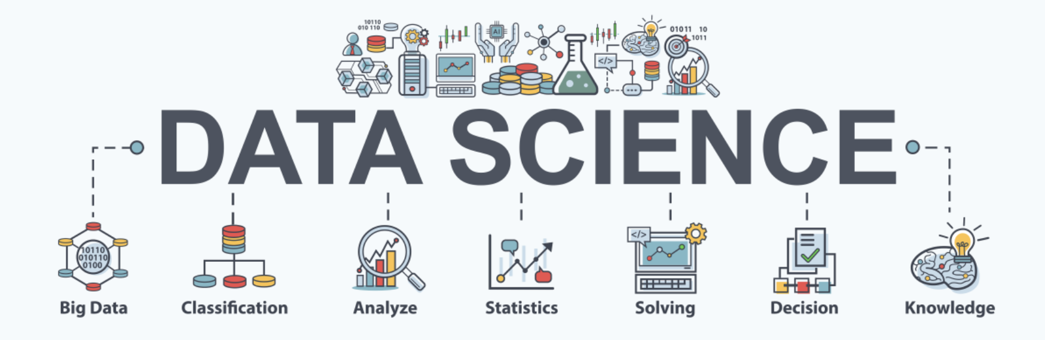
Data Science incorporates several areas such as statistics, scientific techniques, artificial intelligence (AI), and data analysis to extract value from data.
Data Science is the process of preparing data for analysis to obtain actionable insights and discover trends.
Areas of typical use include: finance, healthcare, agriculture, manufacturing, transportation, energy, education, sports and surveillance.

Slide 3
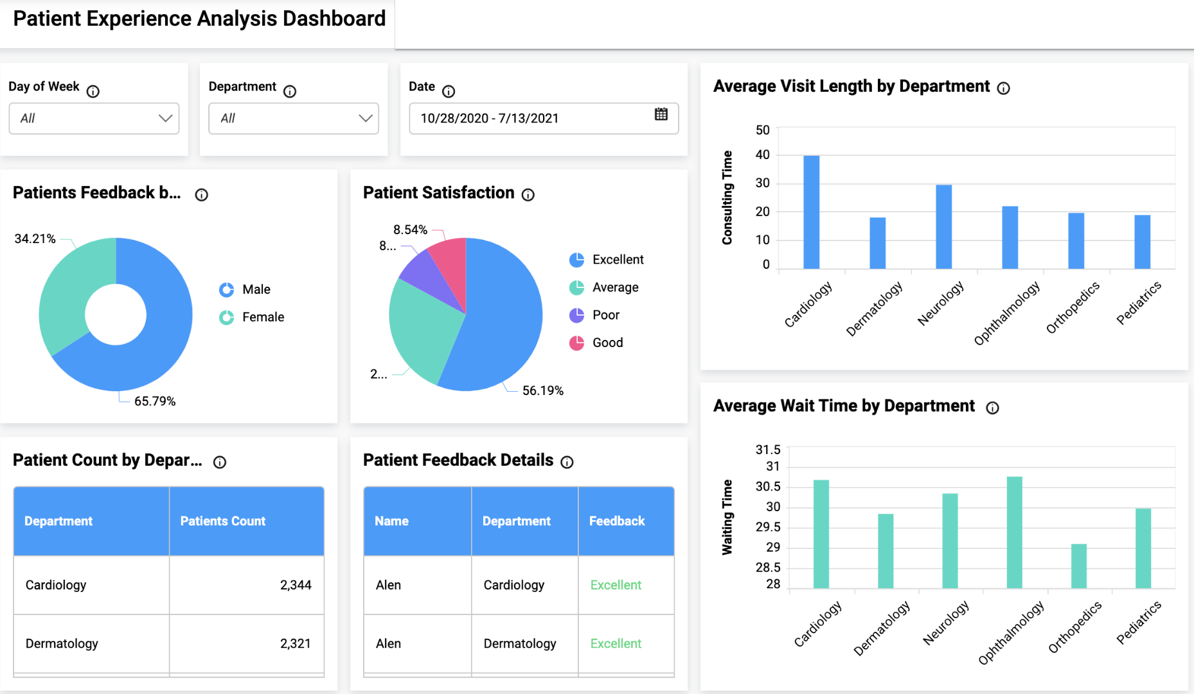
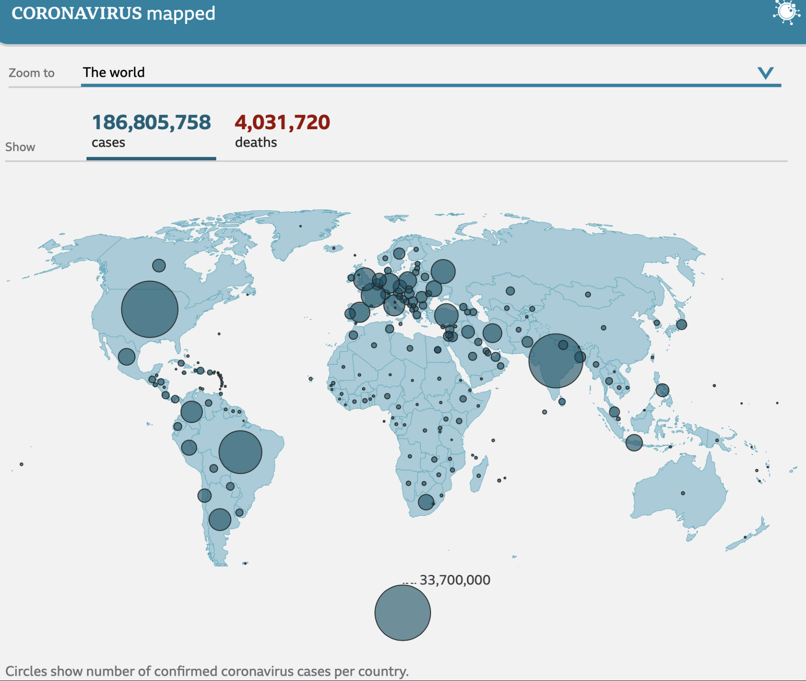
Example – Health and Wellbeing:
Can use data to predict future trends - in case of coronavirus, can make large scale decisions to close businesses, how much PPE to buy, how many vaccinations to produce as well as using data to maximise the quality of those vaccinations. Data science reduces financial risk, helps forecasting and budgeting, and ultimately saves lives. One major downside: rely on human input which is difficult on a global scale.

Slide 4

Example – Snow!
Data Science is being used as we speak to forecast the record breaking cold conditions. Temp in the highlights
fell to -15.4 degrees!
AI provides cheaper approximations for complicated and costly cloud models, which can then be embedded into existing climate and weather forecasting systems - here AI can reduce costs and increase accessibility to data.
Farmers can utilise data to adapt planting and harvesting practices to avoid increasingly unexpected floods, droughts, frosts, and heat waves.
Policy makers and businesses can prepare for climate-related disasters, manage power supplies, plan agriculture, keep transportation running smoothly, among many others. Data also plays an important role to better understand climate change and what needs to be done to improve the current situation.

Slide 5




Summary:
Data plays an important role in most aspects of our life. We can use statistics, computer science, AI, quantitative methods, and big data tools to create more effective public policies and improve our quality of life.
We can utilise current trends and patterns to predict events and thus make better decisions. Businesses can benefit from utilising beautiful data visualization programs to to improve performance and demonstrate the impact of their actions.

